Slide 1




SIMPLE HOME INVENTORY
Presented by Group-4
ID-1841,1843,1844,1845,1846,
1847,1848,1849,1850,1851

Slide 2
Home Inventory ManAGEMENT SYSTEM
A home inventory system helps users organize and manage household items efficiently.
It keeps track of important information such as item name, quantity, category, and price.
Managing household items manually can be time-consuming and difficult.
Our project provides a simple and user-friendly solution for managing home inventory.
The system is developed using Java and Object-Oriented Programming (OOP) concepts.

Slide 3
ISSUES WITH TRADITIONAL INVENTORY TRACKING
01
Difficulty in Managing Household Managing and tracking a large number of household items manually is time-consuming and inconvenient.
03
Lack of Proper Inventory Tracking
It is difficult to keep track of item quantity, location, category, and price efficiently.
02
04
No Easy Low-Stock Monitoring
Identifying items with low quantities can be difficult, which may lead to unexpected shortages.
Managing Multiple Homes is Difficult
Managing inventories across multiple homes and different rooms separately can be complicated.

Slide 4
Objectives
Key Features
Centralized Inventory Management
Easy Home & Room Organization
Efficient Item Tracking
Quick Access to Inventory Information
User Registration & Login
Multiple Home Management
Room Management
Add, Update & Delete Items
Search & Filter Inventory
Inventory Value Calculation
Low-Stock Alerts
Goal:
To provide a simple, organized, and user-friendly solution for managing
household inventory efficiently.

Slide 5
Concepts Used
Object-Oriented Programming (OOP)
Encapsulation
Inheritance
Polymorphism
Abstraction
Database Connectivity (JDBC)
Connection
PreparedStatement
ResultSet
Room-wise Inventory Management
Add/Delete Rooms
Room-based Item Filtering
All Rooms View
Java Swing GUI
JFrame, JPanel, JButton, JTable
JTextField, JComboBox, JOptionPane
Event Handling
ActionListener
DocumentListener
ListSelectionListener

Slide 6
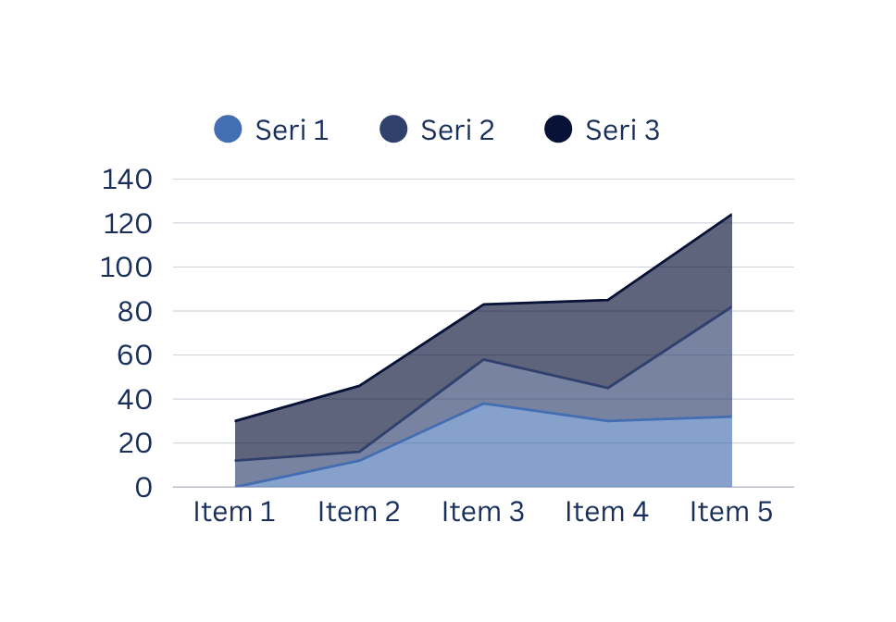
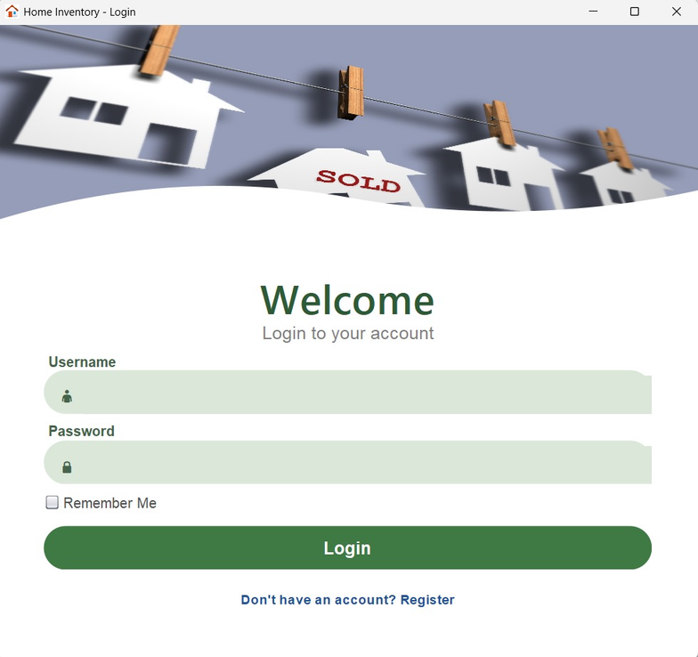


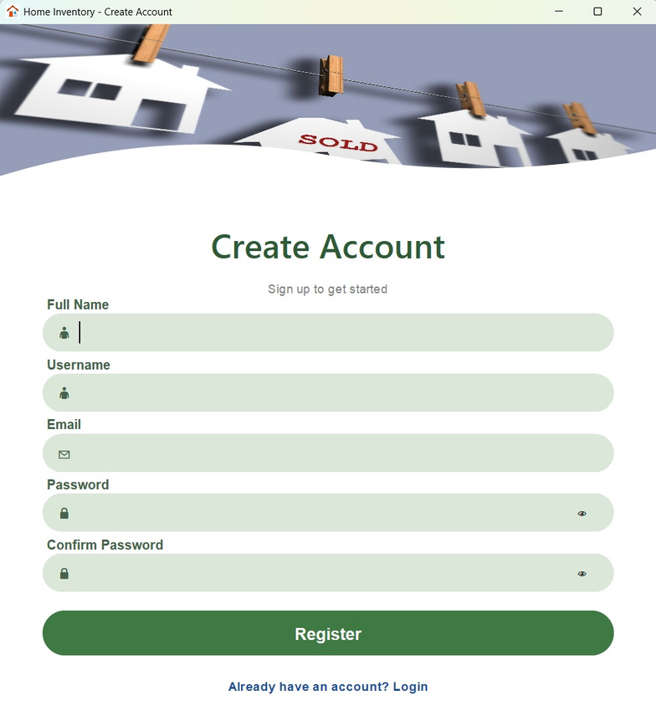

USER AUTHENTICATION
Resgister
page
login Interface

Slide 7

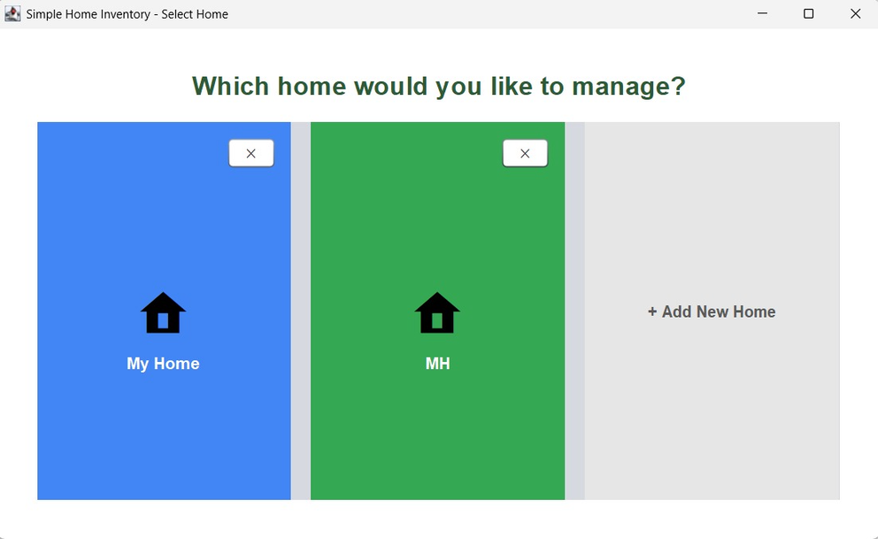
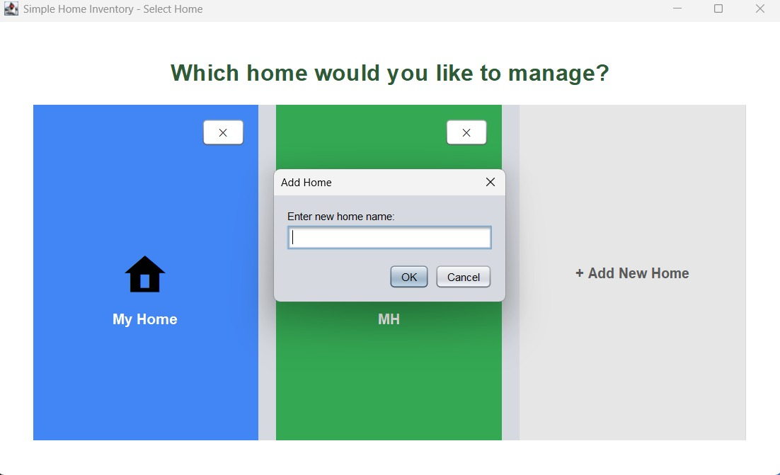
Add new home
HOME DASHBOARD

Slide 8
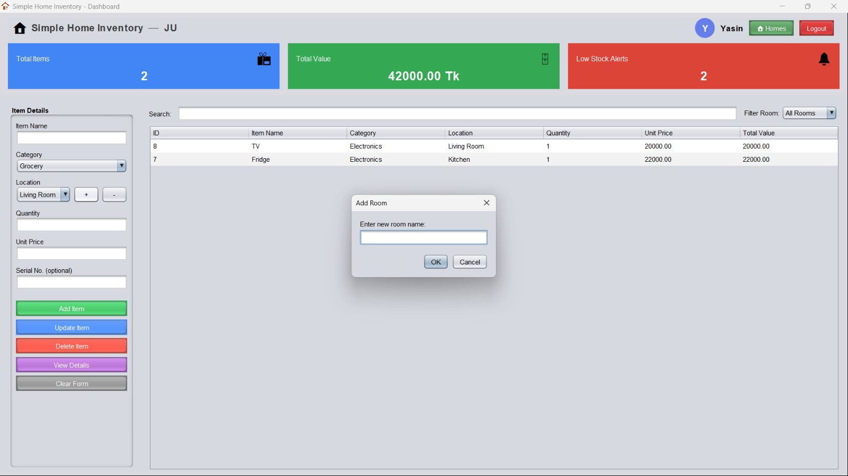

Total items
Search
Total value
Low stock alert
Back to home page
Add item
Category
Location
Quantity
Add new room
Price
Add item
Update item
View Details

Slide 9
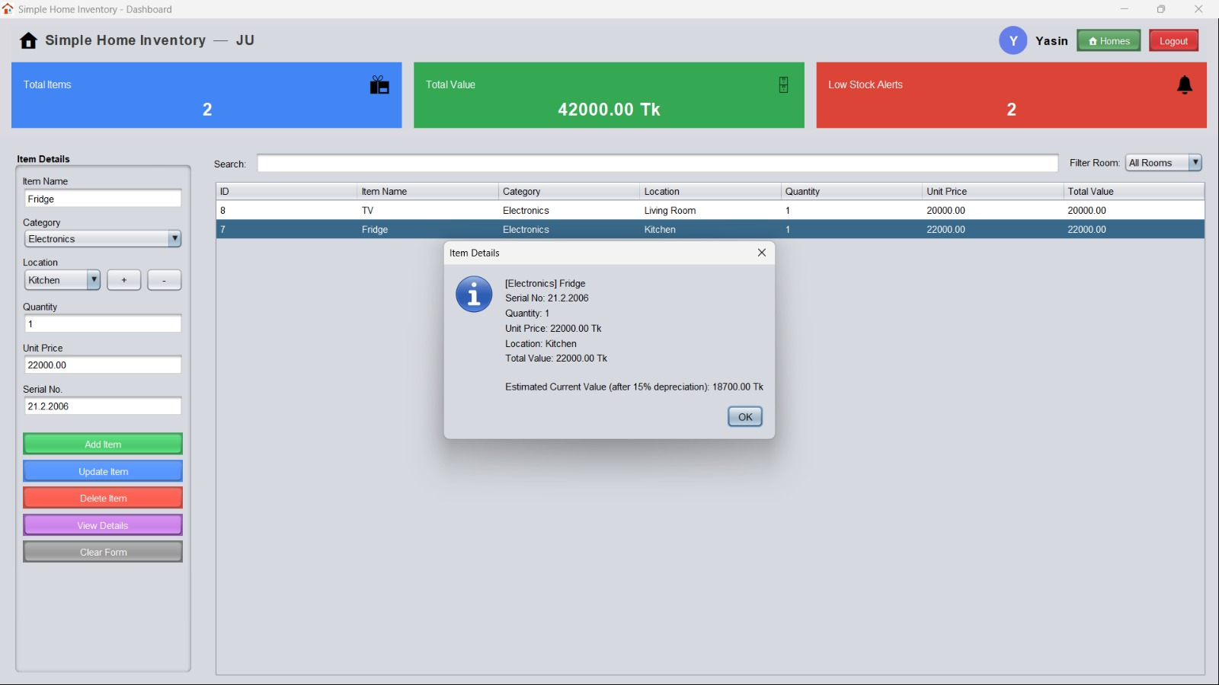


Click view
details

Slide 10
CONCLUSION
Developed a simple and user-friendly Home Inventory Management System using Java.
Successfully implemented essential inventory management features.
Applied Object-Oriented Programming (OOP) concepts in a practical project.
The system makes household item management easier and more organized.
Future Improvements
Add database integration for permanent data storage.
Add user profile and authentication security.
Add inventory reports and notifications.
Develop a GUI/mobile version for better user experience.

Slide 11
THANK YOU

